Slide 1

The Analysis of Current and Future Trends in Technical Skills
Richard Lam
5/24/2025

Slide 2



OUTLINE
Executive Summary
Introduction
Methodology
Results
  Visualization – Charts
  Dashboard
Discussion
  Findings & Implications
Conclusion
Appendix

Slide 3

EXECUTIVE SUMMARY
Current and future demographic studies in computer programming languages,platforms, webframes and databases
Level of education, age, country and gender gap in technological companies
Population in the survey
Data Wrangling, Analysis and Visualization based on the technical skills and careers

Slide 4

INTRODUCTION
This data report is about top trends of computer programming languages, databases, platforms and web frames.
The purpose of this data presentation is to analyze the technical skills in demography.
The main point is that many respondents have or want the technical skills and careers in the demographic data.
Audiences and viewers include college professors and students from computer science department and information technology employees and supervisors.

Slide 5

METHODOLOGY
Data Collection
  Web scraping
  APIs
  Request library
Data Wrangling
  Removing duplicate
  Removing or replacing the missing values
Exploratory Data Analysis
  Handling outliners
  Correlation
Data Visualization
  Comparison and Composition of demographic data
  Data relationships
Dashboard

Slide 6
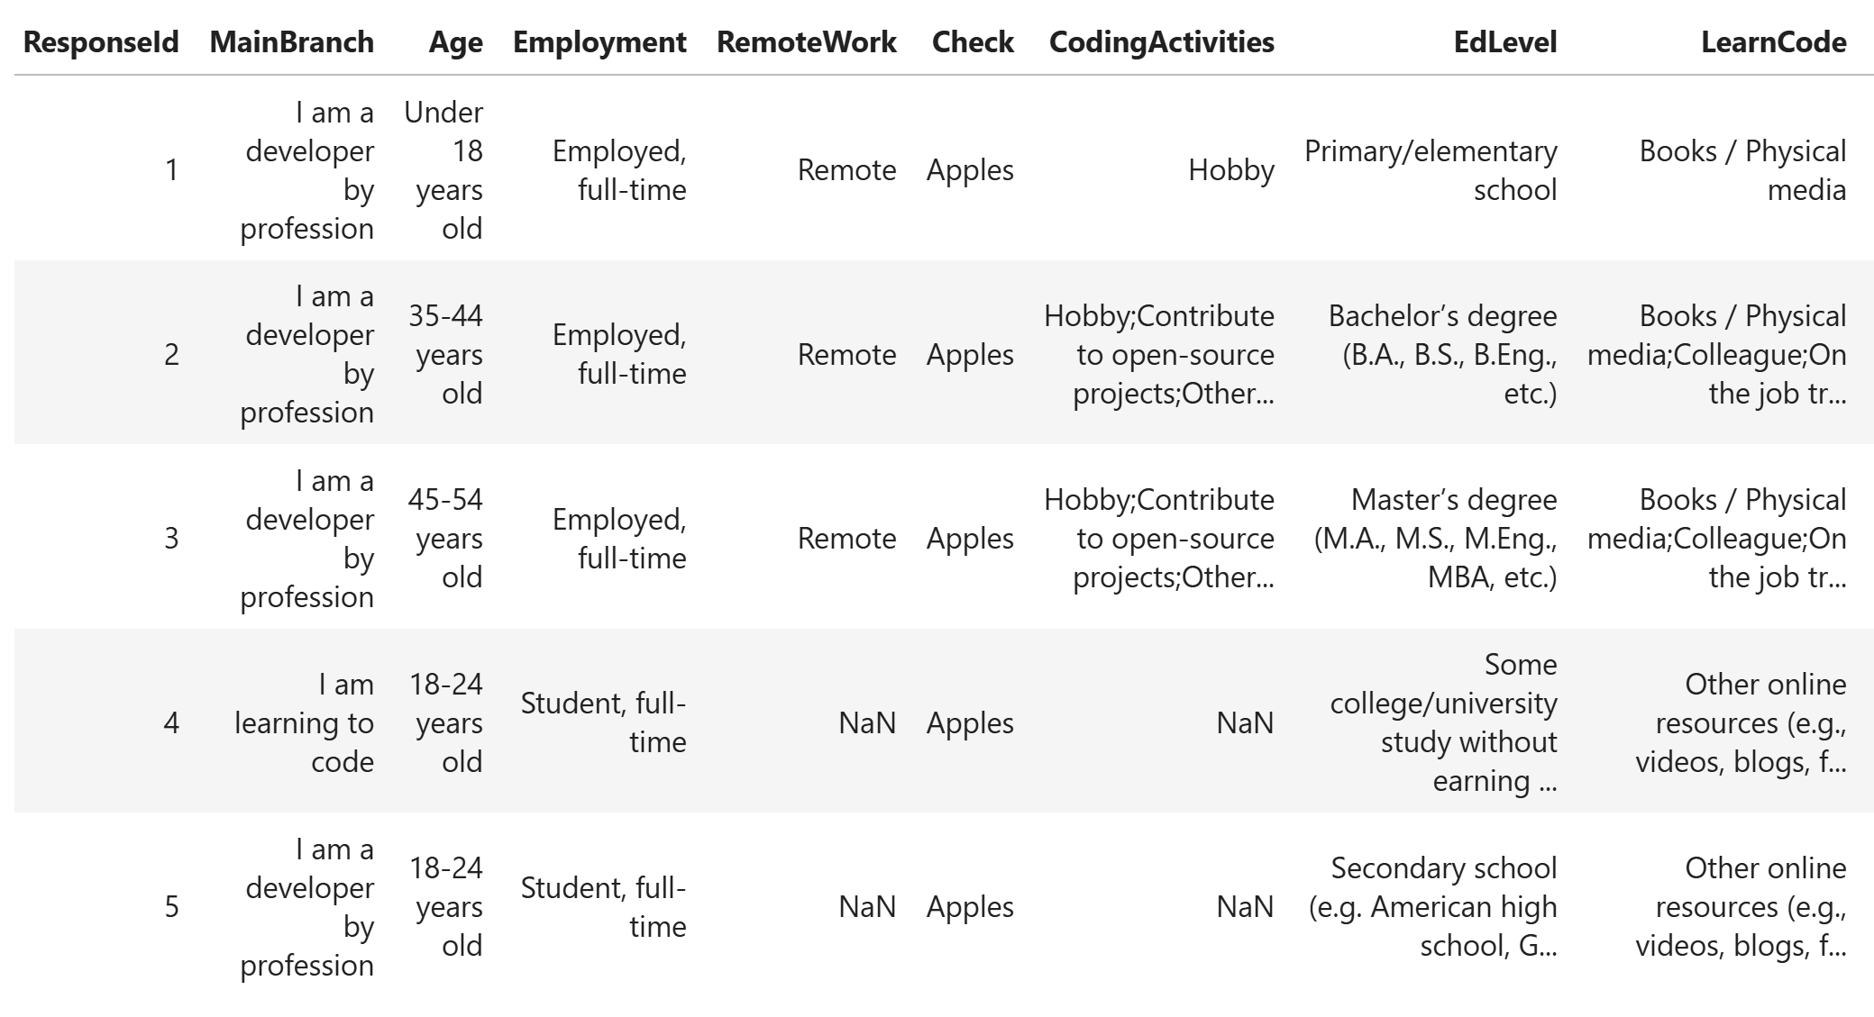
RESULTS

Slide 7
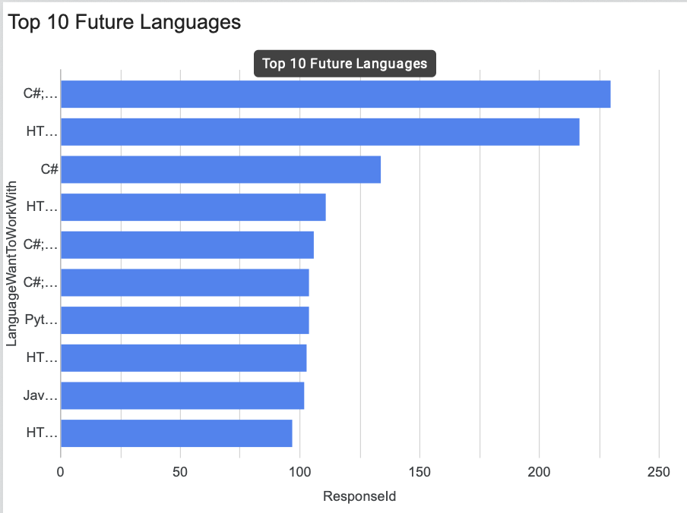
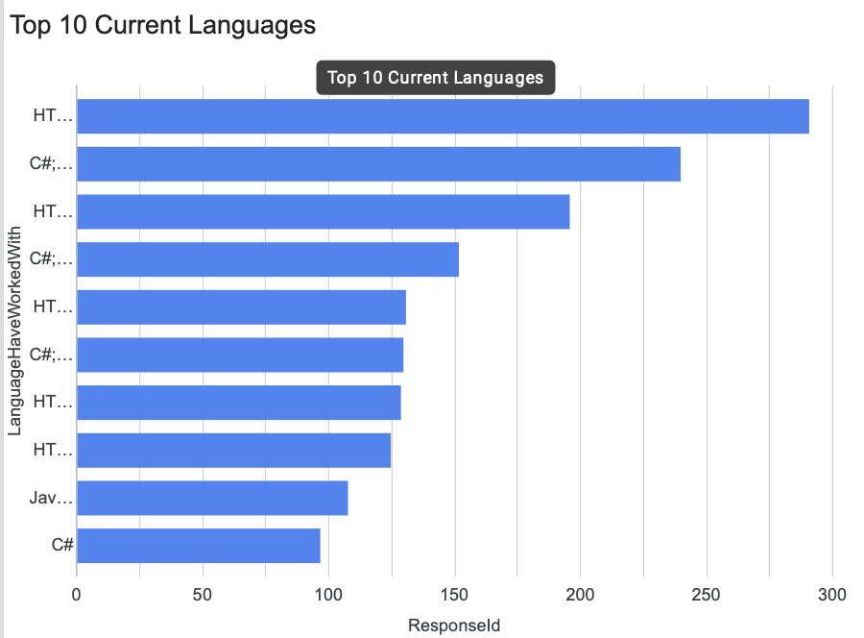
PROGRAMMING LANGUAGE TRENDS
Current Year
Next Year

Slide 8
PROGRAMMING LANGUAGE TRENDS - FINDINGS & IMPLICATIONS
Findings
The amount of C # will increase.
There is the interest in Python.
Implications
Python will establish in the market.

Slide 9
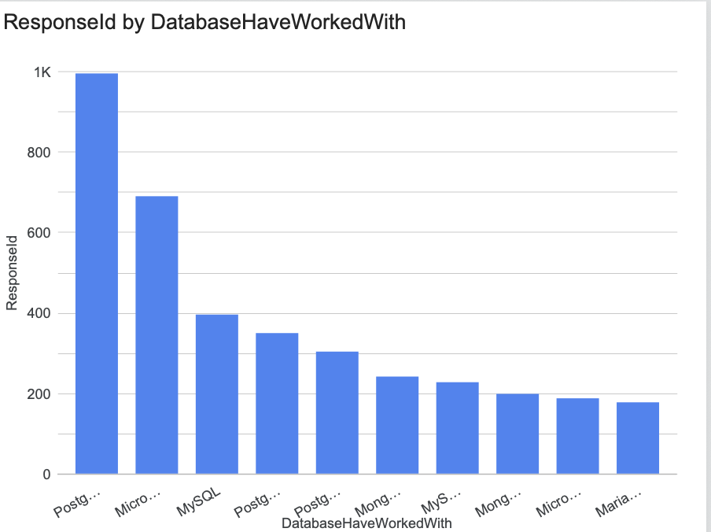
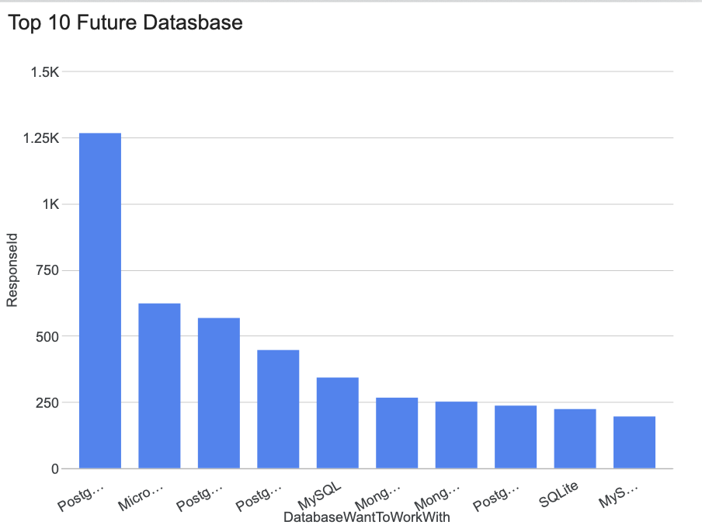
DATABASE TRENDS
Current Year
Next Year

Slide 10
DATABASE TRENDS - FINDINGS & IMPLICATIONS
Findings
Postgre SQL is the most popular database in the technology.
The amount of programmers and developers who works MySQL will decrease in future.
The amount of Microsoft SQL Server will decrease in future, but the amount of MongoDB will increase in future.
Implications
SQLite will establish in the market.

Slide 11

DASHBOARD
https://datastudio.google.com/reporting/c7acff36-2028-40be-b1d0-bd4acad88b50/page/p_39ttod3v3d/edit

Slide 12
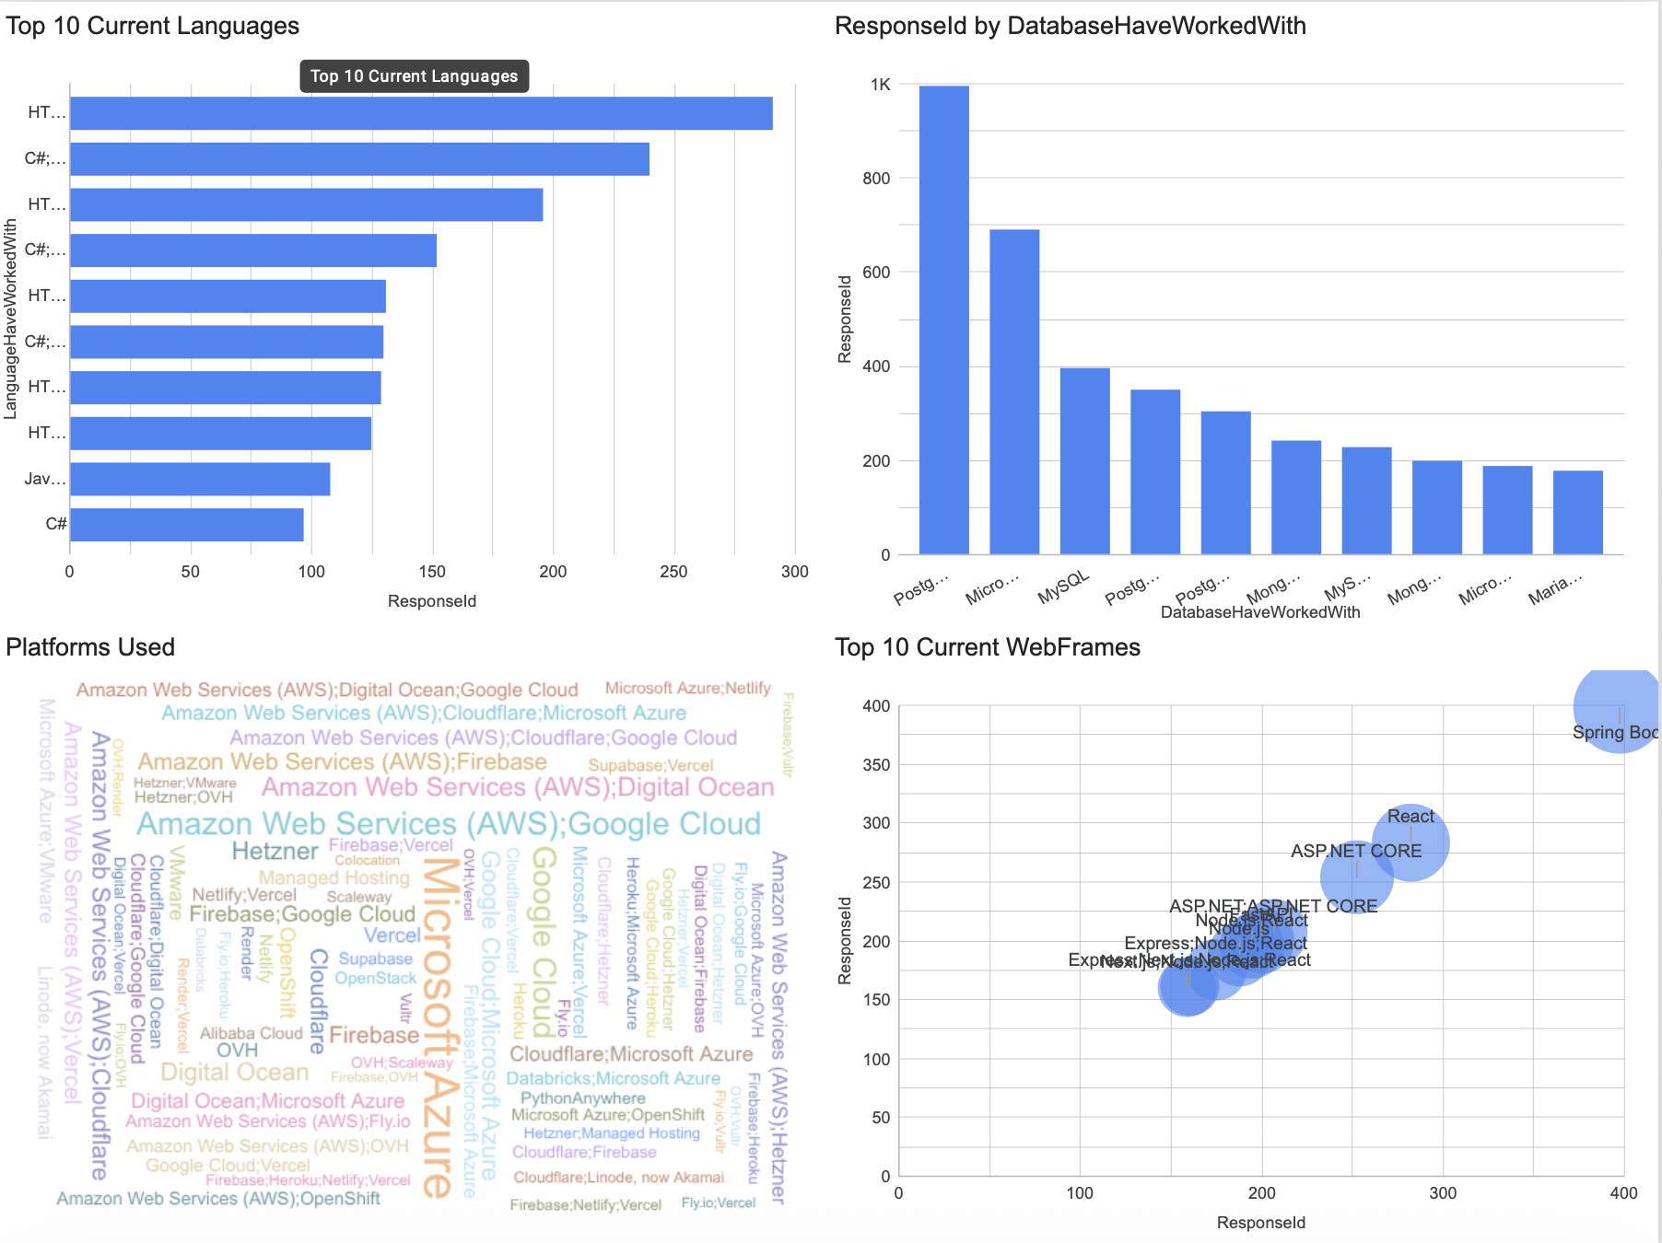
DASHBOARD TAB 1

Slide 13
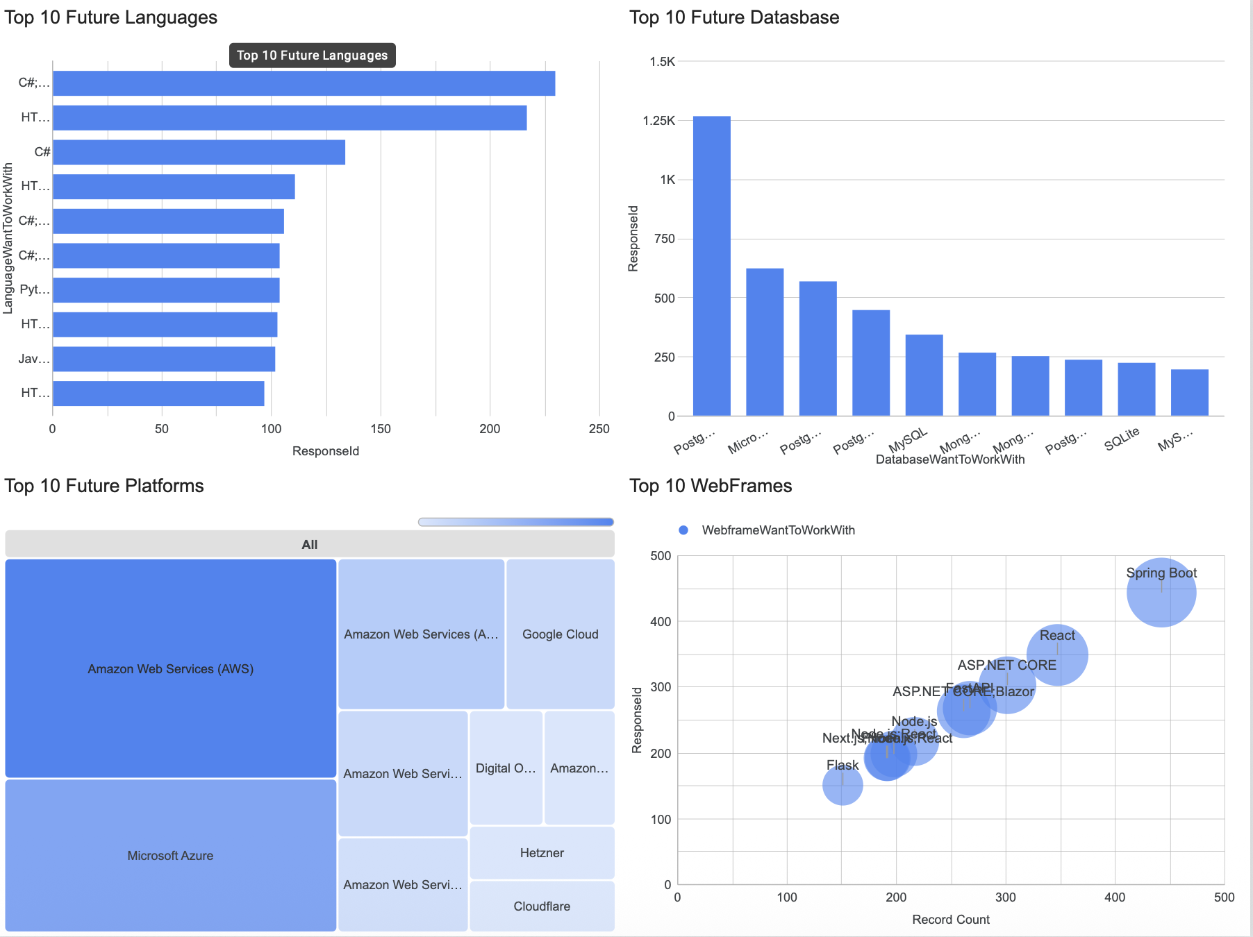
DASHBOARD TAB 2

Slide 14
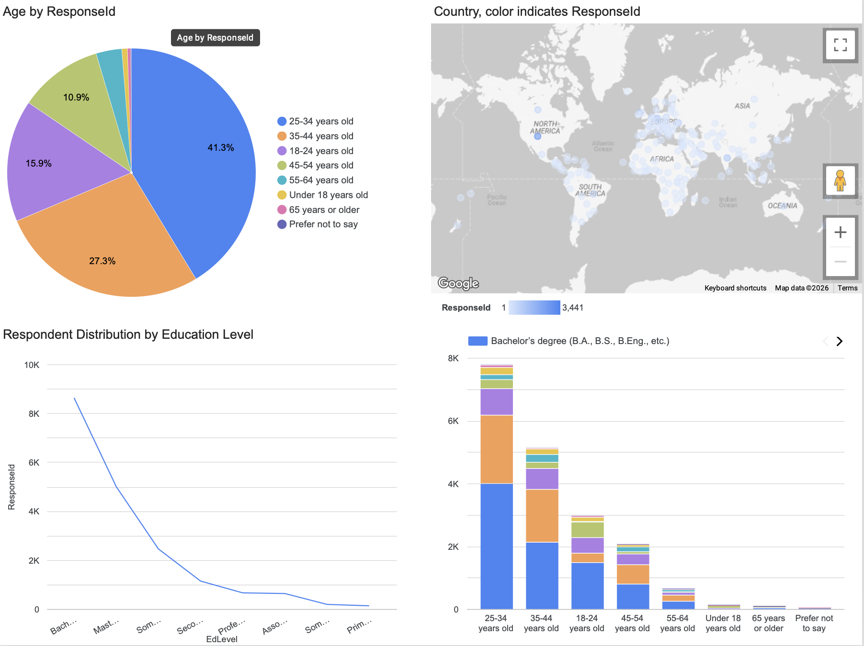
DASHBOARD TAB 3

Slide 15
DISCUSSION
There are technology trends in current and future times.
There are developers and programmers with age and education gap in the technical society.

Slide 16
OVERALL FINDINGS & IMPLICATIONS
Findings
There are 42% of developers and programmers with 25 – 34 years old.
There are gender, age and education gaps in the technical society.
There is the concentration in the country like the United States.
Implications
There are the younger developers without the postgraduate degree.
The developers and Programmers should understand the current and future technology trends.
The companies should spread technology out to one of the countries.

Slide 17

CONCLUSION
There are recent and new technology trends
There are programmers and developers with age and education.
The demographic studies depend on salaries.
The programmers and developers focus on databases, computer programming languages, web frames and platforms in current and future trends.

Slide 18

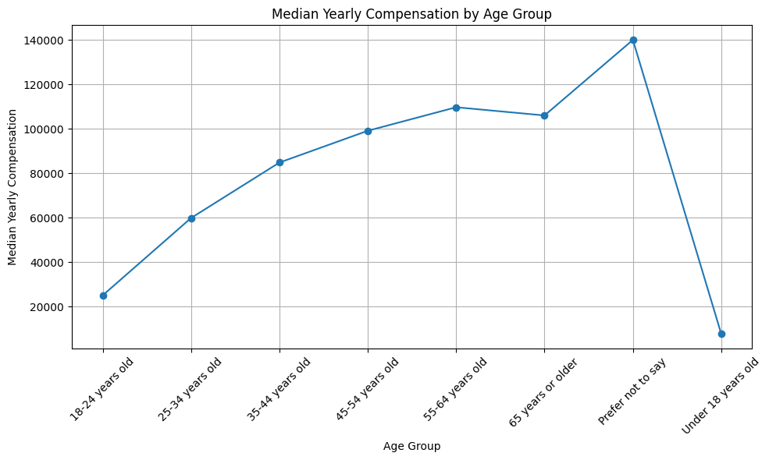
APPENDIX

Slide 19
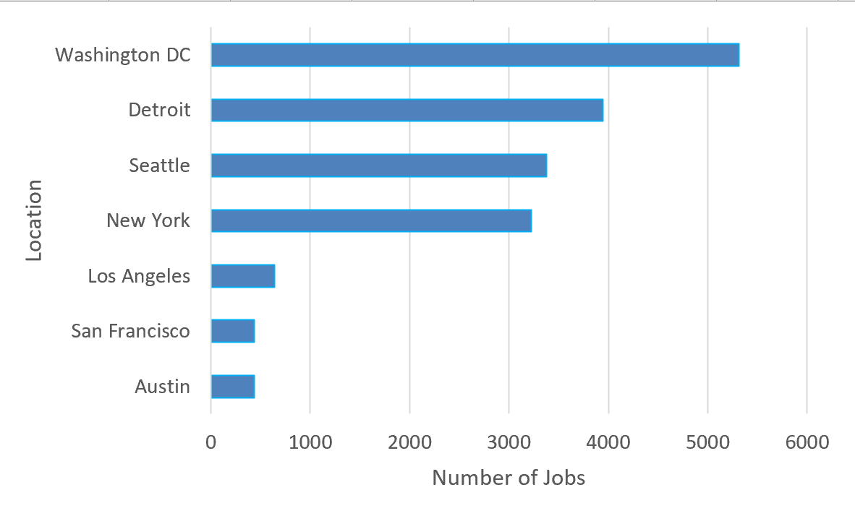
JOB POSTINGS

Slide 20
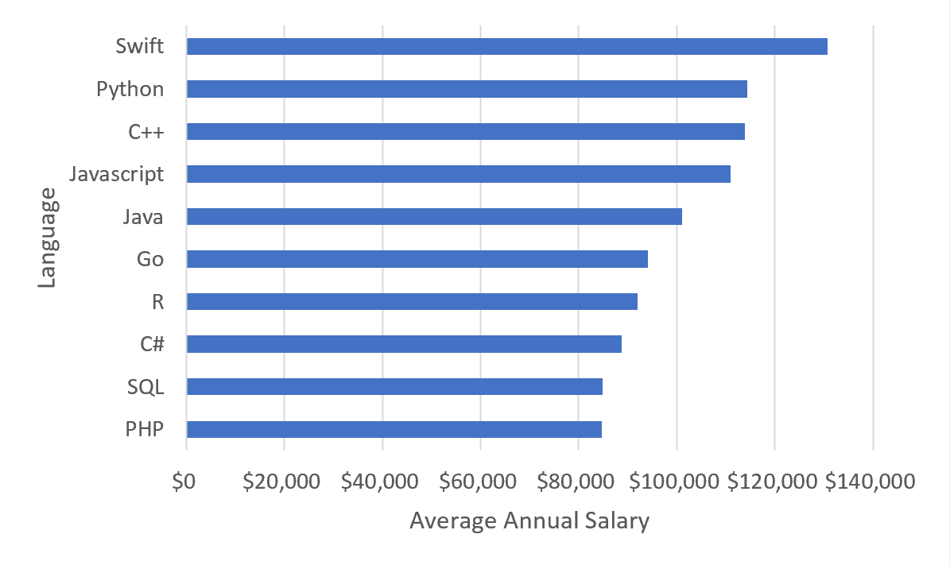
POPULAR LANGUAGES

